Slide 1
-Didn’t capture the river pulse in 2020
- Similar pattern for groundwater being highest in the fall

Slide 2
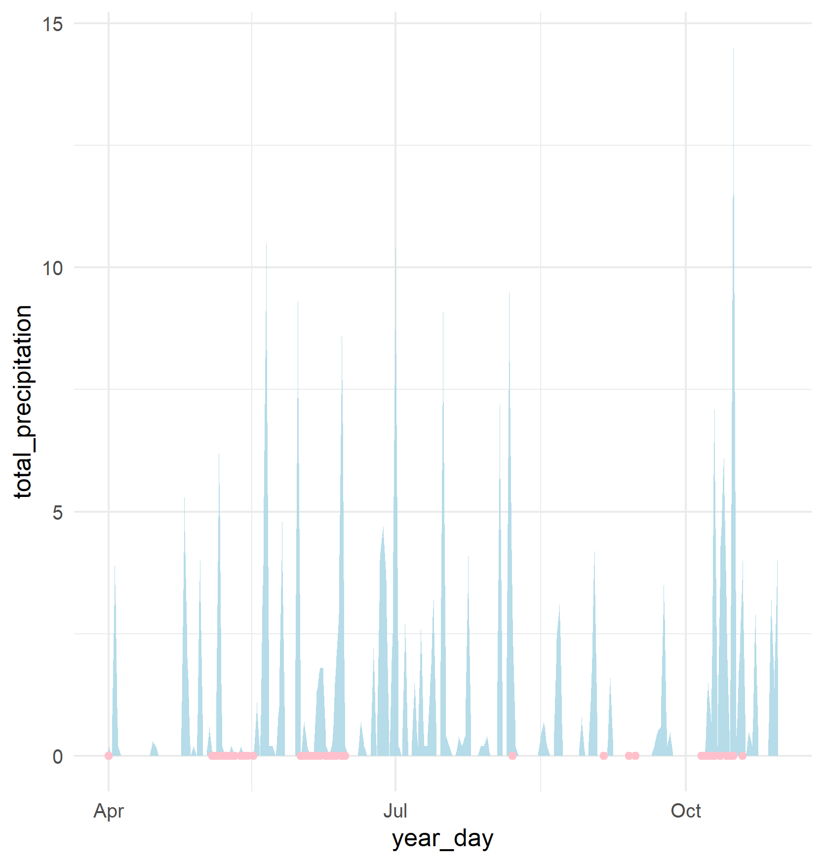
Precip during fall sampling corresponds with higher precip found in the wetlands
Not as clear for the spring, could be residual from fall 2019 or snow?

Slide 3
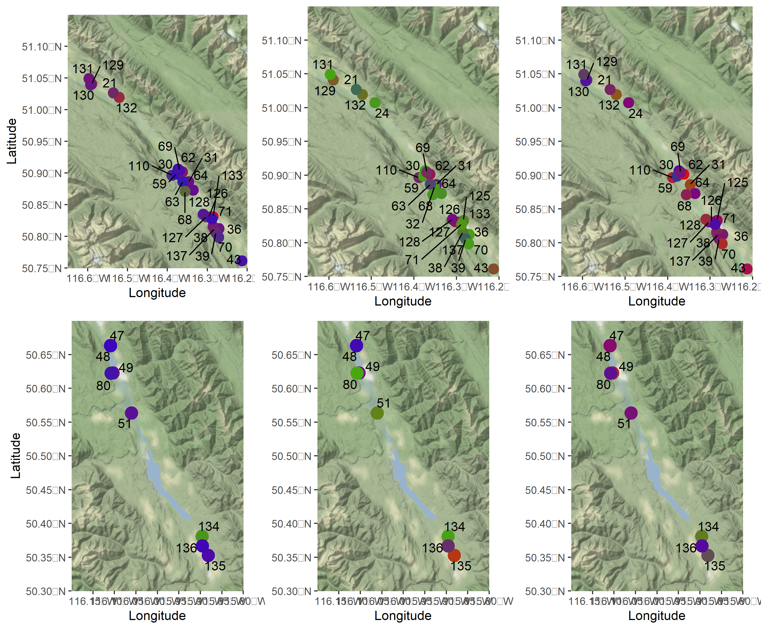
No obvious spatial pattern to input proportions
- Could calculate distance to river or something of the like, but is it informative?

